Slide 1

Audit in the present times:
Pertinent Ethical issues
CA Satish Vaidyanathan
sathishv83@gmail.com

Slide 2
Ethics
The Ethics in contemporary terms is not a domain that has to be separate from the practical world, but is very much a part of it.
It has to be inculcated in the habit and temperament of the individual, so that there is an overall culture of ethics; the force has to be strong enough to withstand any selfish motive or temptation.
Credible and Trusted

Slide 3





Auditors: current day pertinent ethical issues
Independence
Gross negligence
Professional misconduct
Due care
Self aware
Self-interest threat
Of Mind (any influences)
Of Appearance (any facts avoided)
Ignorance cannot be bliss
Asking the right questions - Skepticism
Know your Auditing and accounting standards
Lead by example
Giving the due care and caution to audits.
Taking time to deliberate issues
NOCLAR
Continuously upskill yourself

Slide 4
Question
The auditor was aware of a mismatch in short term payables and receivables of the company involved in the audit. The director of the Company had assured the auditor that this was a short-term liquidity crunch and provided a net worth certificate of one of its largest debtor. This certificate, however, did not indicate a net worth that covered the full amount loaned.
Is this an issue?
Yes, The auditor is at fault for relying on this certificate and the statement of the director of the company when assessing the recoverability of the company’s loans.
Did not evaluate the capacity and competencies of the firm that issued a net worth certificate. Auditors are thus required to strictly comply with SAs, violation of these would invite strict publishment and penalty

Slide 5
Question
Which of the following is NOT a fundamental principle in the Code of Ethics for Chartered Accountants?
Integrity
Objectivity
Professional Scepticism
Confidentiality

Slide 6
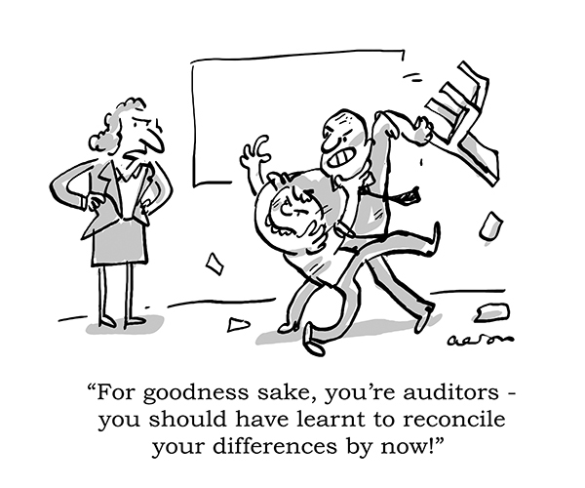
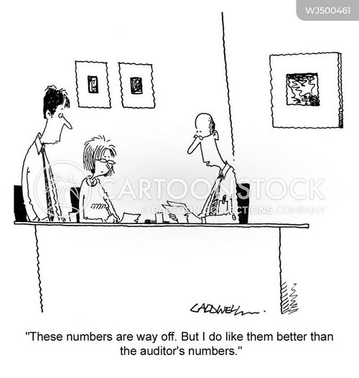
Auditor in Present times and challenges

Slide 7
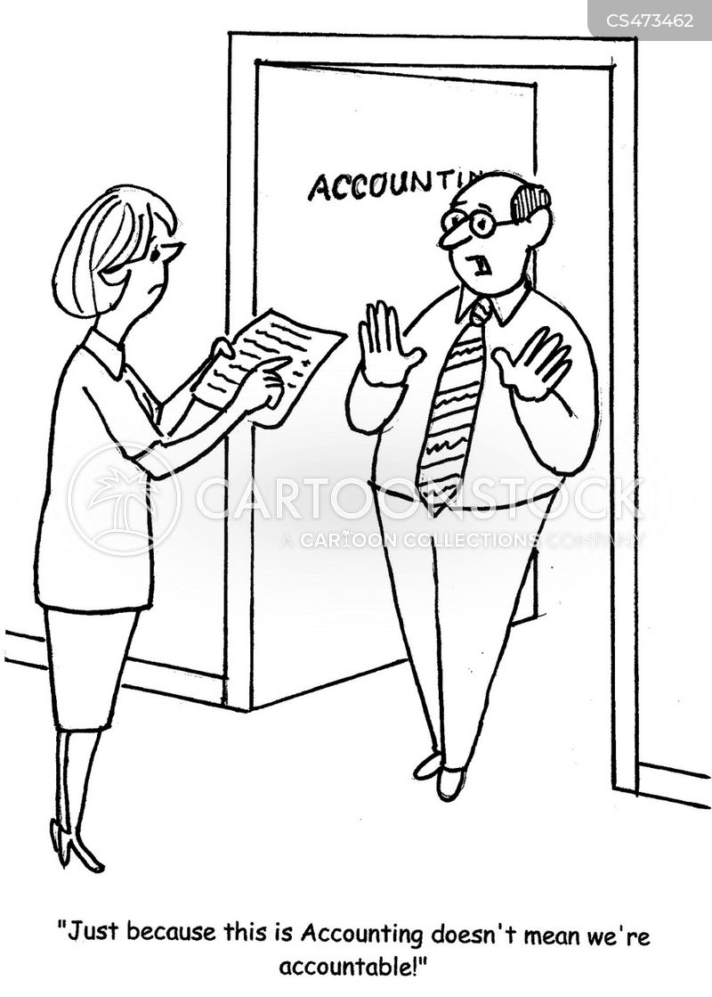
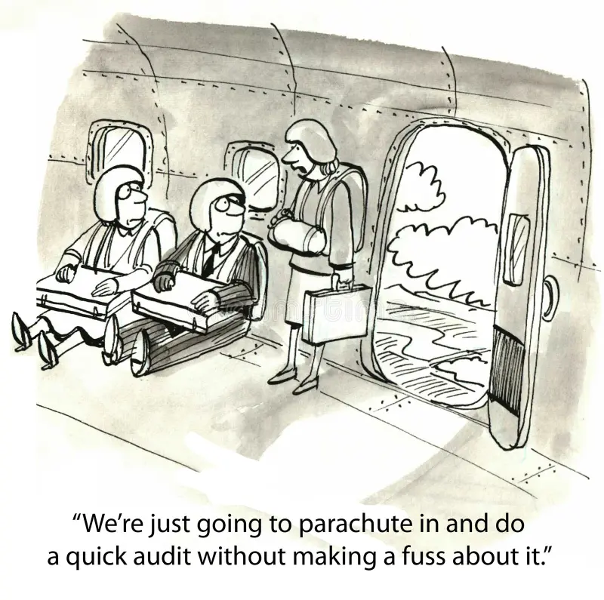
Auditor in Present times and challenges

Slide 8
Intimidation threat
Describe the concept of "Intimidation Threat" and give an example
An intimidation threat occurs when a professional accountant is deterred from acting objectively due to actual or perceived pressures, often from influential individuals. This pressure may cause the accountant to compromise their ethical standards to please a client or superior.
Example: An accountant is threatened with dismissal if they do not agree with the client's aggressive tax treatment, which could violate tax laws. The threat creates pressure to comply, even though the action may be unethical.

Slide 9
NOCLAR
What is the primary objective of NOCLAR?
NOCLAR (Non-Compliance with Laws and Regulations) is designed to address situations where a professional accountant encounters, or is made aware of, non-compliance by a client or employer. Its primary objective is to: Protect the public interest by ensuring that accountants act appropriately when they become aware of illegal or unethical actions. Ensure that non-compliance is reported to management, governance, or, in some cases, regulatory authorities, while maintaining professional confidentiality.

Slide 10
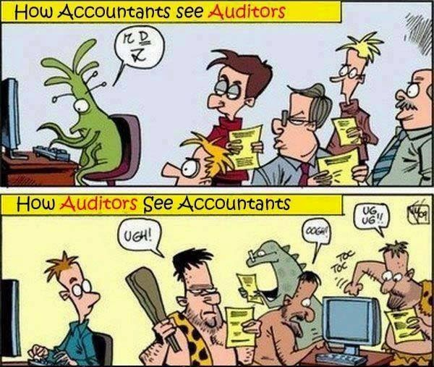
ROTFL

Slide 11
The
Fundamental
Principles of Ethics
Integrity
to be straightforward and honest in all professional and business relationships.
Objectivity
not to compromise professional or business judgments because of bias, conflict of interest or undue influence of others.
Professional competence and care
Attain and maintain professional knowledge and skill at the level required.
Act diligently and in accordance with applicable technical and professional standards.
confidentiality
to respect the confidentiality of information acquired as a result of professional and business relationships.
Professional behavior
comply with relevant laws and regulations and avoid any conduct that the professional accountant knows or should know might discredit the profession.

Slide 12

Threats to Fundamental Principles
Self-interest threats
Self-review threats
Financial or other interests inappropriately influencing judgment.
Inability to objectively evaluate previous work.
Advocacy threats
Familiarity threats
Promoting a client's position to the detriment of objectivity.
Close relationships compromising objectivity.
Intimidation threat
Pressures deterring objective action

Slide 13
Question
What is the primary safeguard against a self-review threat in an audit engagement?
Using a different partner for review
Delaying the audit
Offering discounts to clients
Combining services

Slide 14
Question
Which category of threats involves the risk of personal financial interest influencing a professional’s objectivity?
Familiarity
Self-interest
Intimidation
Advocacy

Slide 15





Examples of threats to principles
Self interest threats
Self-review threats:
Advocacy threats:
Familiarity threats
Intimidation threats
Direct financial interest in a client.
Quoting low fees that may hinder professional service standards.
Close business relationships with clients.
Accessing confidential information for personal gain.
Issuing an assurance report on financial systems implemented by the accountant.
Using original data prepared by the accountant for an assurance engagement.
Promoting a client's interests, even if it compromises objectivity.
Advocating for a client in litigation or disputes.
Lobbying for legislation on behalf of a client.
Close relationships with family members who are client directors or officers.
Long associations with individuals influencing client business decisions.
Threats of dismissal for disagreement on professional matters.
Pressure to agree with client judgment when the accountant lacks expertise.
Accepting gifts from clients with the threat of disclosure.

Slide 16
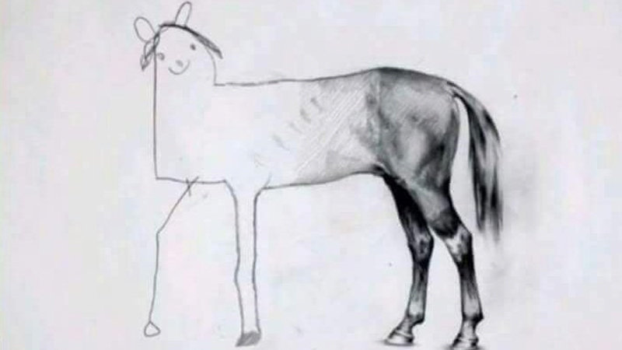
Importance of Ethical practices
When ethics take a miss
Audit with integrity

Slide 17
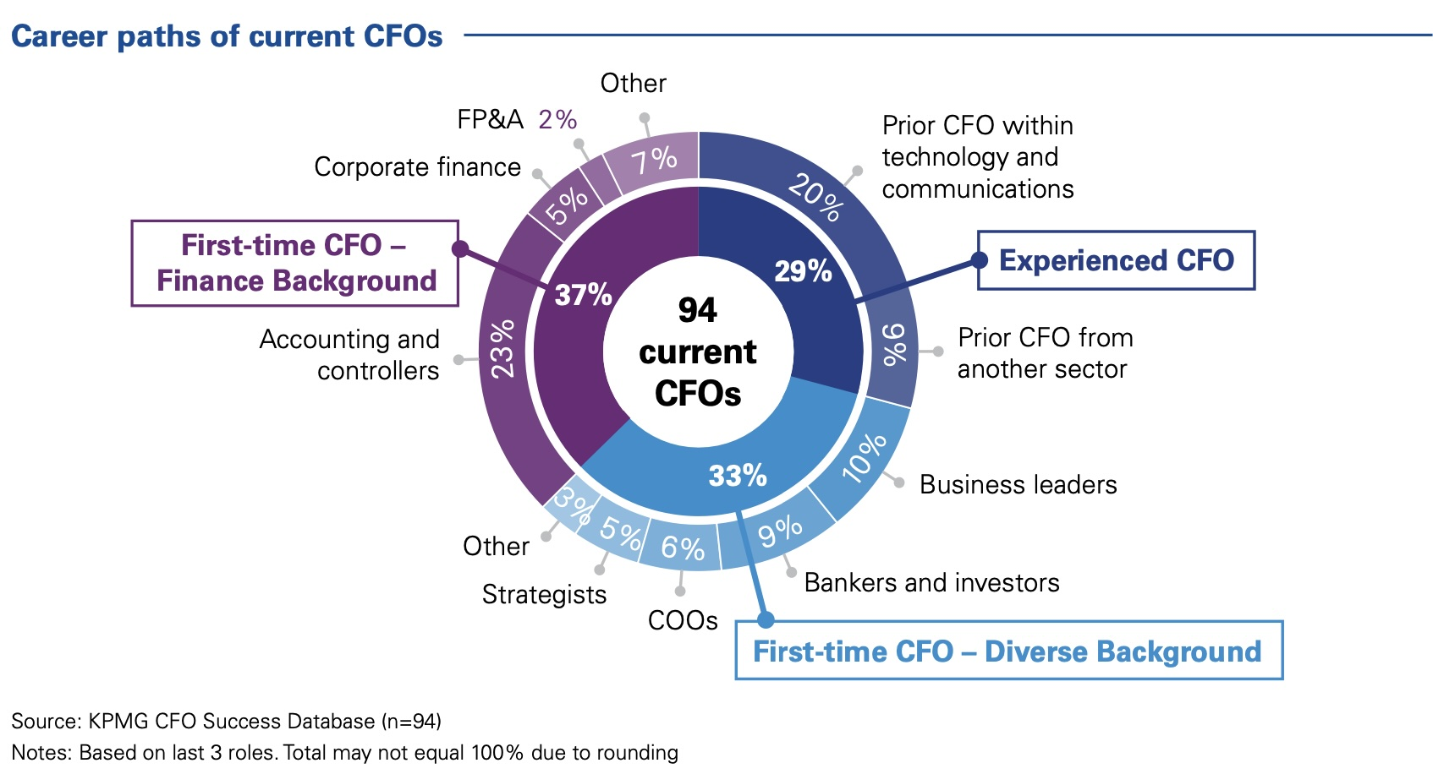
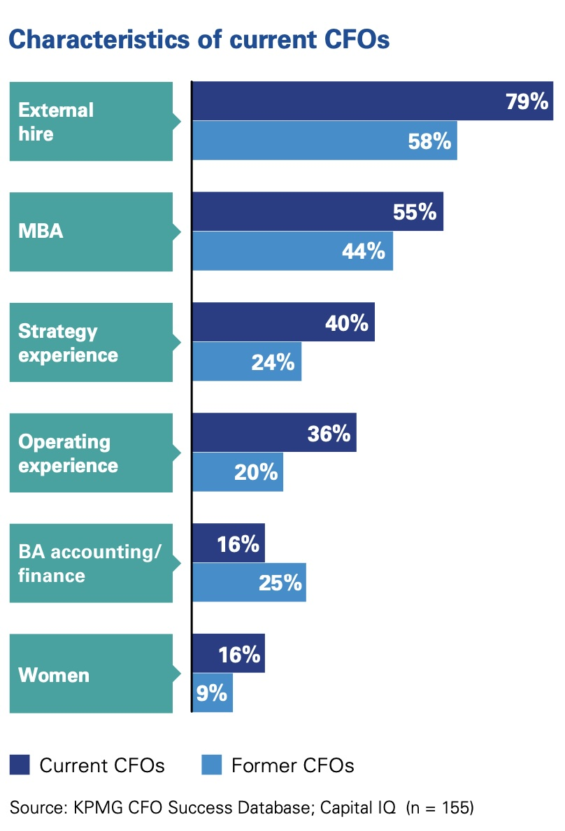
Whom do auditors face today
Who is your CFO today

Slide 18
Question
If an accountant uncovers NOCLAR during an engagement, what is the first recommended action?
Report to the authorities
Ignore it
Obtain an understanding of the matter
Resign from the engagement

Slide 19
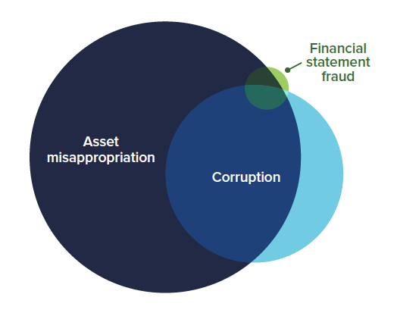
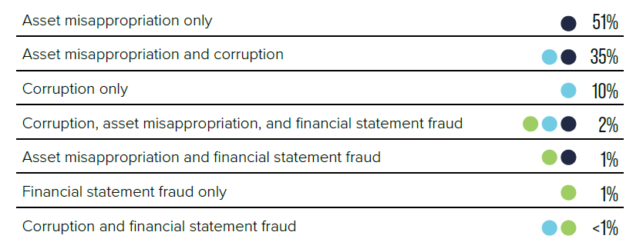
What’s happening in 2024?

Slide 20
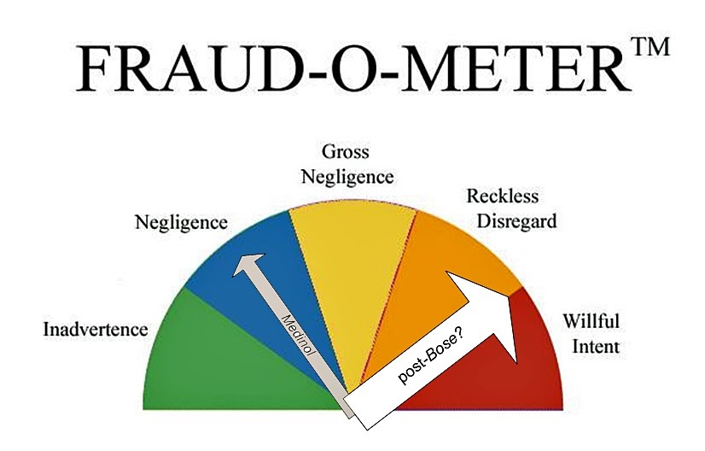
Frauds and forms
Fraud may be by
False representation
Failing to disclose information
Abuse of position

Slide 21
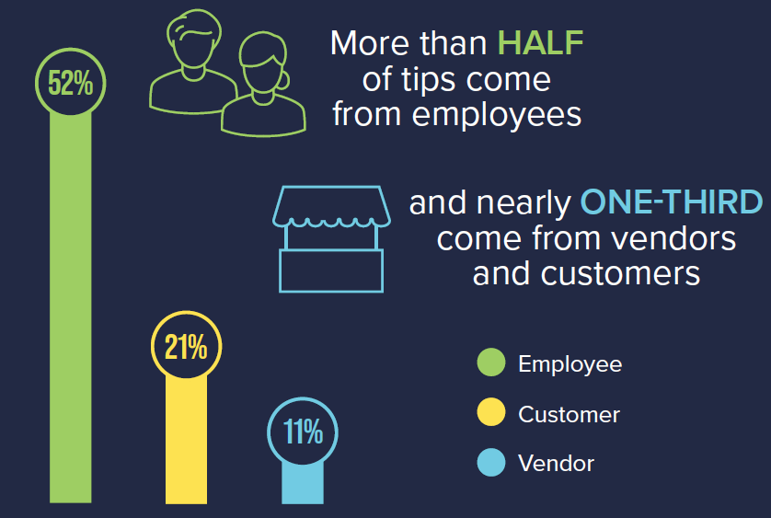
Where to look for information/ inquiries
Did you know?
The Association of Certified Fraud Examiners (ACFE)’s Report to the Nations published in 2024 has found that a typical fraud case lasts for up to 12 months before detection.

Slide 22





NFRA, where auditors are faltering
Gross negligence
Professional misconduct
Independence
Risk Assessment
No Documentation
Wrong reports
Did not discharge professional duties
Omissions and commissions
Self review threats
Ineligible appointments
Inability to identify risks
Ignorance of critical Accounting and auditing principles

Slide 23
Some recent changes to tighten monitoring
CARO 2020 ushered in higher standards of transparency in reporting the financial health of a company with better implementation of the whistleblower policy in letter and spirit
The CARO 2020 report and FAQs - a consolidated guide for all corporate stakeholders for early identification of lags, misdemeanours and deviations from compliance norms
Amendments to LODR Regulations and NFRA guidance in line with these strengthened compliance requirements and plug the gap in unequal access to disclosures concerning listed entities.
Auditors expected to intensify scrutiny of process and procedures followed by the company along with prompt reporting of all findings of all internal investigations and reviews.
Inevitable involvement of specialist teams assisting the auditors with forensic reviews, risk assessment and overall legal opinion on auditor’s exercise of prudence and judgment in reporting.

Slide 24
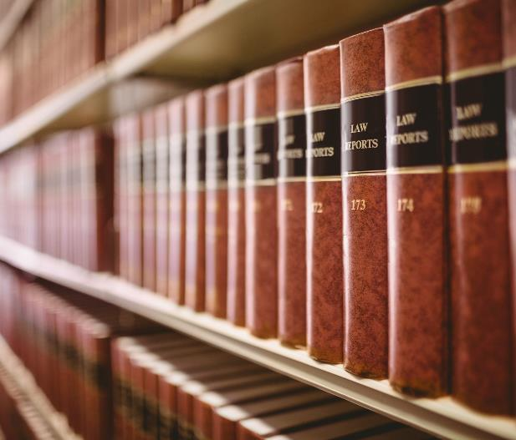

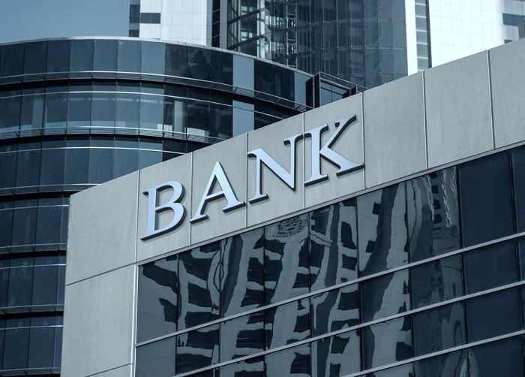


Audit in present times
Excellence
Governance & Controls
Accounting
Reporting
Agile
Proactive
Understand business
TCWG
Risk management
Skills and behaviour
Quality controls
Technology
Upskill
Self-Awareness – Internal
Risks prior to acceptance
NOCLAR
Culture – External
Nation building
Cybersecurity
Analysis, Automation, AI
Are we just a watch dog?

Slide 25
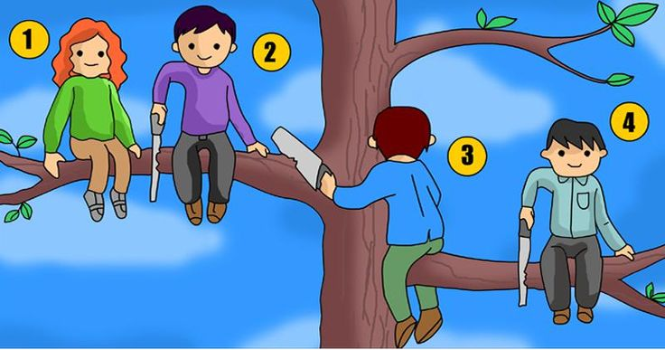

Who is the most stupid here

Slide 26

Thank you
CA Satish Vaidyanathan
9884102000
sathishv83@gmail.com

